Slide 1
Graph algorithms
Part 2

Slide 2
Topological sort
Linear ordering of vertices such that for every directed edge uv, vertex u comes before v in the ordering

Slide 3
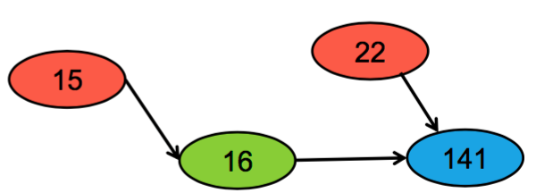
Topological sort. Example
Valid Topological Orderings:
15,22,16,141
15,16,22,141
22,15,16,141

Slide 4
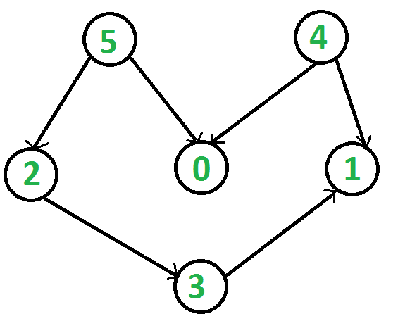
DAG properties
No cycles
Simple paths – Every path will end
At least 1 vertex with no successors(the end of the world)
Remove 1 vertex – still DAG

Slide 5
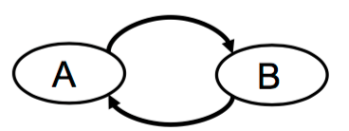
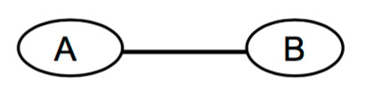
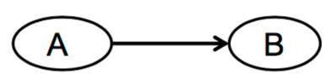
What graphs to use ?
NO
NO
YES! DAG only

Slide 6
Topological sort. Algorithm
• If a node is a source, there are no prerequisites, so we can visit it!
• Once we visit a node, we can delete all of its outgoing edges
• Deleting edges might create new sources, which we can now visit!
Data Structures Needed:
DAG to topologically-sorting
Set of all sources (represented by a stack)
List for our topological ordering

Slide 7
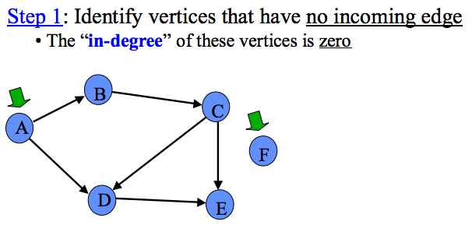
Topological sort run – through

Slide 8
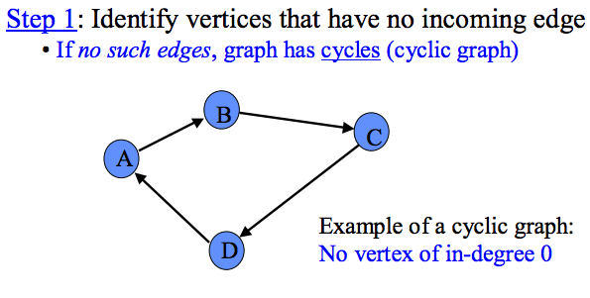
Topological sort run – through

Slide 9
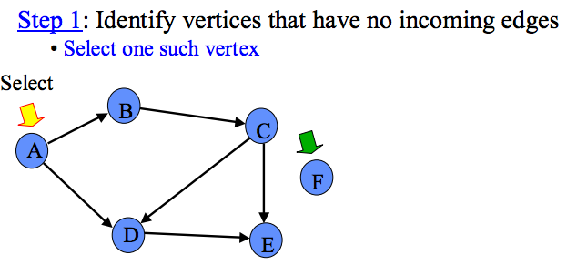
Topological sort run – through

Slide 10
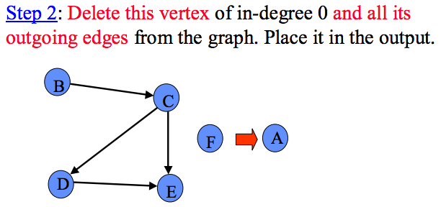
Topological sort run – through

Slide 11
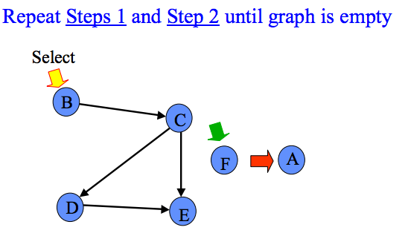
Topological sort run – through

Slide 12
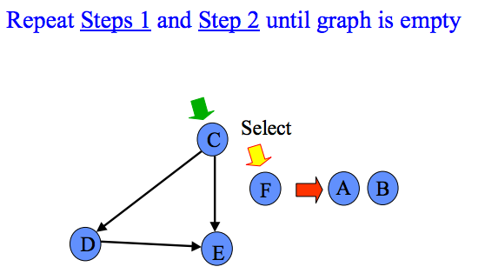
Topological sort run – through

Slide 13
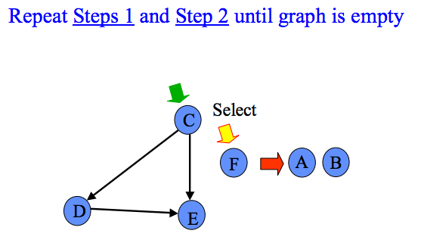
Topological sort run – through

Slide 14
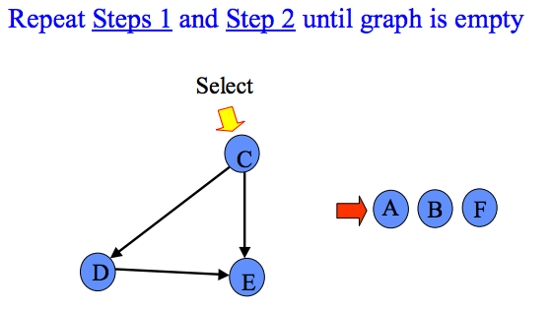
Topological sort run – through

Slide 15
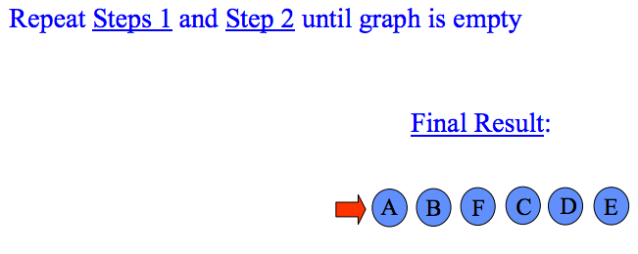
Topological sort run – through

Slide 16
Topological sort. Other algorithm
Find one lonely vertex (there can be few of them) at the end of the world. Attach this vertex to the left of the list.
2) Remove this vertex and all the adjacent edges from the graph.
3) Repeat 1-2 until graph is empty OR we find a cycle (no lonely edges).

Slide 17
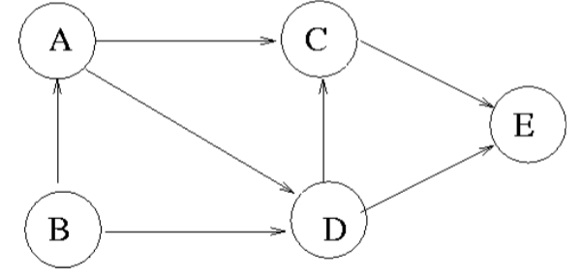
Exercise

Slide 18
Shortest path: Dijkstra algorithm
Find unvisited vertex Vi with minimal calculated path length
Consider all simple paths, where Vi is the pre-last vertex
get all adjacent nodes to Vj (let’s call them Vj) and calculate new path length for each as PL(Vj) = PL(Vi) + |(Vi, Vj)|. If this values is smaller that already assigned to a node – replace with smaller. If you want to restore the path – replace also “origin value” for Vi.

Slide 19
Dijkstra’s algorithm
B
5
D
4
6
A
8
Z
1
2
2
3
C
10
E

Slide 20
All-Pair Shortest Path
Simple solution: call Dijkstra’s algorithm from each of the n possible starting vertices (hence n x n distance matrix)
Floyd-Warshall algorithm
Construct n x n shortest-path distance matrix directly from original n x n weight matrix
Use adjacency matrix instead of adjacency list data structure

Slide 21
All-Pair Shortest Path
Runs in O(n³) time
Increases number of hops allowed by one with each iteration
A
30
D
5
20
Iteration | Distance | Path
B
5
5
C

Slide 22
All-Pair Shortest Path
Runs in O(n³) time
Increases number of hops allowed by one with each iteration
A
30
D
5
20
Iteration | Distance | Path
0 | 30 | A-D
B
5
5
C

Slide 23
All-Pair Shortest Path
Runs in O(n³) time
Increases number of hops allowed by one with each iteration
A
30
D
5
20
Iteration | Distance | Path
0 | 30 | A-D
1 | 25 | A-B-D
B
5
5
C

Slide 24
All-Pair Shortest Path
Runs in O(n³) time
Increases number of hops allowed by one with each iteration
A
30
D
5
20
Iteration | Distance | Path
0 | 30 | A-D
1 | 25 | A-B-D
2 | 15 | A-B-C-D
B
5
5
C

Slide 25
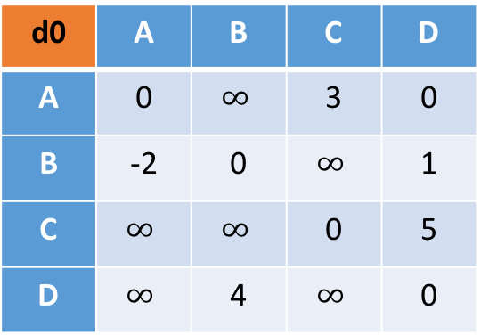
First iteration: pitstop at A
to
d0 | A | B | C | D
A | 0 | $$∞$$ | 3 | 0
B | -2 | 0 | $$∞$$ | 1
C | $$∞$$ | $$∞$$ | 0 | 5
D | $$∞$$ | 4 | $$∞$$ | 0
A
-2
B
from
3
1
4
0
C
D
5

Slide 26
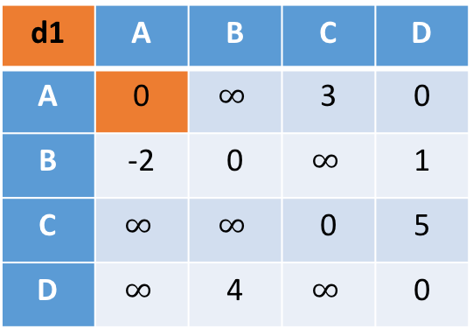
First iteration: pitstop at A
to
d0 | A | B | C | D
A | 0 | $$∞$$ | 3 | 0
B | -2 | 0 | $$∞$$ | 1
C | $$∞$$ | $$∞$$ | 0 | 5
D | $$∞$$ | 4 | $$∞$$ | 0
A
-2
B
from
3
1
4
0
to
C
D
d1 | A | B | C | D
A | 0 | $$∞$$ | 3 | 0
B | -2 | 0 | $$∞$$ | 1
C | $$∞$$ | $$∞$$ | 0 | 5
D | $$∞$$ | 4 | $$∞$$ | 0
5
from
AA + AA < AA? NO

Slide 27
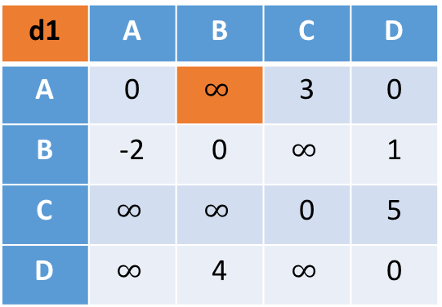
First iteration: pitstop at A
to
d0 | A | B | C | D
A | 0 | $$∞$$ | 3 | 0
B | -2 | 0 | $$∞$$ | 1
C | $$∞$$ | $$∞$$ | 0 | 5
D | $$∞$$ | 4 | $$∞$$ | 0
A
-2
B
from
3
1
4
0
to
C
D
d1 | A | B | C | D
A | 0 | $$∞$$ | 3 | 0
B | -2 | 0 | $$∞$$ | 1
C | $$∞$$ | $$∞$$ | 0 | 5
D | $$∞$$ | 4 | $$∞$$ | 0
5
from
AB + BA < AB? NO

Slide 28
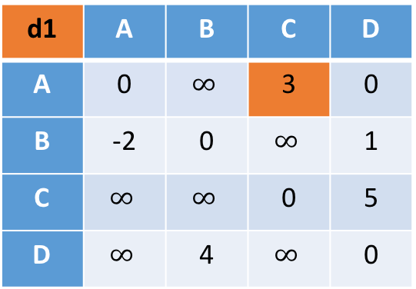
First iteration: pitstop at A
to
d0 | A | B | C | D
A | 0 | $$∞$$ | 3 | 0
B | -2 | 0 | $$∞$$ | 1
C | $$∞$$ | $$∞$$ | 0 | 5
D | $$∞$$ | 4 | $$∞$$ | 0
A
-2
B
from
3
1
4
0
to
C
D
d1 | A | B | C | D
A | 0 | $$∞$$ | 3 | 0
B | -2 | 0 | $$∞$$ | 1
C | $$∞$$ | $$∞$$ | 0 | 5
D | $$∞$$ | 4 | $$∞$$ | 0
5
from
AC + CA < AC? NO

Slide 29
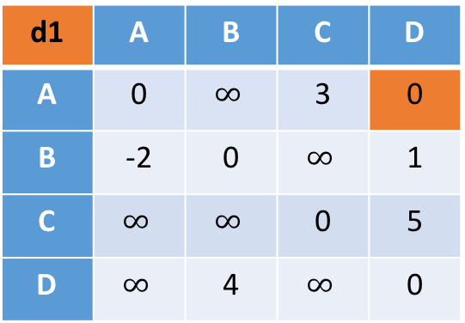
First iteration: pitstop at A
to
d0 | A | B | C | D
A | 0 | $$∞$$ | 3 | 0
B | -2 | 0 | $$∞$$ | 1
C | $$∞$$ | $$∞$$ | 0 | 5
D | $$∞$$ | 4 | $$∞$$ | 0
A
-2
B
from
3
1
4
0
to
C
D
d1 | A | B | C | D
A | 0 | $$∞$$ | 3 | 0
B | -2 | 0 | $$∞$$ | 1
C | $$∞$$ | $$∞$$ | 0 | 5
D | $$∞$$ | 4 | $$∞$$ | 0
5
from
AD + DA < AD? NO

Slide 30
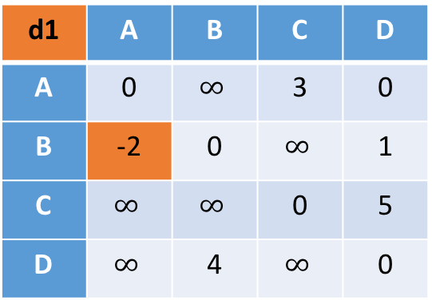
First iteration: pitstop at A
to
d0 | A | B | C | D
A | 0 | $$∞$$ | 3 | 0
B | -2 | 0 | $$∞$$ | 1
C | $$∞$$ | $$∞$$ | 0 | 5
D | $$∞$$ | 4 | $$∞$$ | 0
A
-2
B
from
3
1
4
0
to
C
D
d1 | A | B | C | D
A | 0 | $$∞$$ | 3 | 0
B | -2 | 0 | $$∞$$ | 1
C | $$∞$$ | $$∞$$ | 0 | 5
D | $$∞$$ | 4 | $$∞$$ | 0
5
from
BA + AA < BA? NO

Slide 31
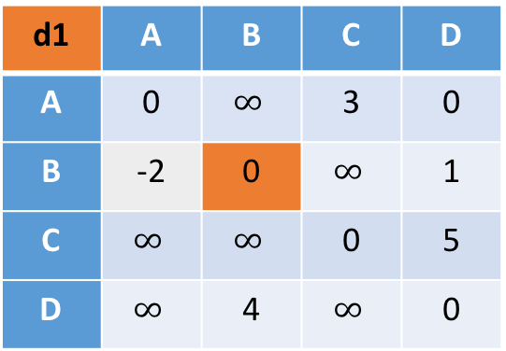
First iteration: pitstop at A
to
d0 | A | B | C | D
A | 0 | $$∞$$ | 3 | 0
B | -2 | 0 | $$∞$$ | 1
C | $$∞$$ | $$∞$$ | 0 | 5
D | $$∞$$ | 4 | $$∞$$ | 0
A
-2
B
from
3
1
4
0
to
C
D
d1 | A | B | C | D
A | 0 | $$∞$$ | 3 | 0
B | -2 | 0 | $$∞$$ | 1
C | $$∞$$ | $$∞$$ | 0 | 5
D | $$∞$$ | 4 | $$∞$$ | 0
5
from
BA + AB < BA? NO

Slide 32
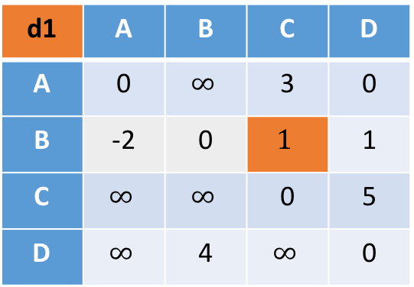
First iteration: pitstop at A
to
d0 | A | B | C | D
A | 0 | $$∞$$ | 3 | 0
B | -2 | 0 | $$∞$$ | 1
C | $$∞$$ | $$∞$$ | 0 | 5
D | $$∞$$ | 4 | $$∞$$ | 0
A
-2
B
from
3
1
4
0
to
C
D
d1 | A | B | C | D
A | 0 | $$∞$$ | 3 | 0
B | -2 | 0 | $$1$$ | 1
C | $$∞$$ | $$∞$$ | 0 | 5
D | $$∞$$ | 4 | $$∞$$ | 0
5
from
BA + AC < BC? YES

Slide 33
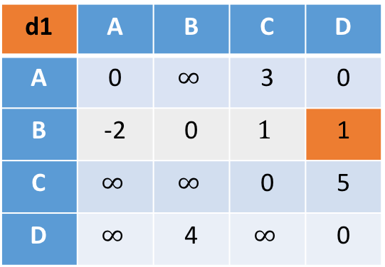
First iteration: pitstop at A
to
d0 | A | B | C | D
A | 0 | $$∞$$ | 3 | 0
B | -2 | 0 | $$∞$$ | 1
C | $$∞$$ | $$∞$$ | 0 | 5
D | $$∞$$ | 4 | $$∞$$ | 0
A
-2
B
from
3
1
4
0
to
C
D
d1 | A | B | C | D
A | 0 | $$∞$$ | 3 | 0
B | -2 | 0 | $$1$$ | 1
C | $$∞$$ | $$∞$$ | 0 | 5
D | $$∞$$ | 4 | $$∞$$ | 0
5
from
BA + AD < BD? NO

Slide 34

First iteration: pitstop at A
to
d0 | A | B | C | D
A | 0 | $$∞$$ | 3 | 0
B | -2 | 0 | $$∞$$ | 1
C | $$∞$$ | $$∞$$ | 0 | 5
D | $$∞$$ | 4 | $$∞$$ | 0
A
-2
B
from
3
1
4
0
to
C
D
d1 | A | B | C | D
A | 0 | $$∞$$ | 3 | 0
B | -2 | 0 | $$1$$ | -2
C | $$∞$$ | $$∞$$ | 0 | 5
D | $$∞$$ | 4 | $$∞$$ | 0
5
from
BA + AD < BD? YES

Slide 35
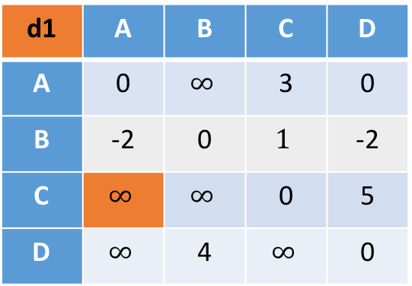
First iteration: pitstop at A
to
d0 | A | B | C | D
A | 0 | $$∞$$ | 3 | 0
B | -2 | 0 | $$∞$$ | 1
C | $$∞$$ | $$∞$$ | 0 | 5
D | $$∞$$ | 4 | $$∞$$ | 0
A
-2
B
from
3
1
4
0
to
C
D
d1 | A | B | C | D
A | 0 | $$∞$$ | 3 | 0
B | -2 | 0 | $$1$$ | -2
C | $$∞$$ | $$∞$$ | 0 | 5
D | $$∞$$ | 4 | $$∞$$ | 0
5
from
CA + AA < CA? NO

Slide 36
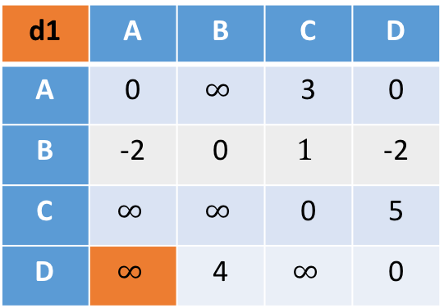
First iteration: pitstop at A
to
d0 | A | B | C | D
A | 0 | $$∞$$ | 3 | 0
B | -2 | 0 | $$∞$$ | 1
C | $$∞$$ | $$∞$$ | 0 | 5
D | $$∞$$ | 4 | $$∞$$ | 0
A
-2
B
from
3
1
4
0
to
C
D
d1 | A | B | C | D
A | 0 | $$∞$$ | 3 | 0
B | -2 | 0 | $$1$$ | -2
C | $$∞$$ | $$∞$$ | 0 | 5
D | $$∞$$ | 4 | $$∞$$ | 0
5
from
DA + AA < DA? NO

Slide 37
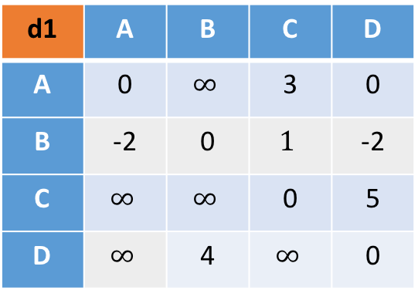
Second iteration: pitstop at B
to
d0 | A | B | C | D
A | 0 | $$∞$$ | 3 | 0
B | -2 | 0 | $$∞$$ | 1
C | $$∞$$ | $$∞$$ | 0 | 5
D | $$∞$$ | 4 | $$∞$$ | 0
A
-2
B
from
3
1
4
0
to
C
D
d1 | A | B | C | D
A | 0 | $$∞$$ | 3 | 0
B | -2 | 0 | $$1$$ | -2
C | $$∞$$ | $$∞$$ | 0 | 5
D | $$∞$$ | 4 | $$∞$$ | 0
5
from
DA + AA < DA? NO

Slide 38
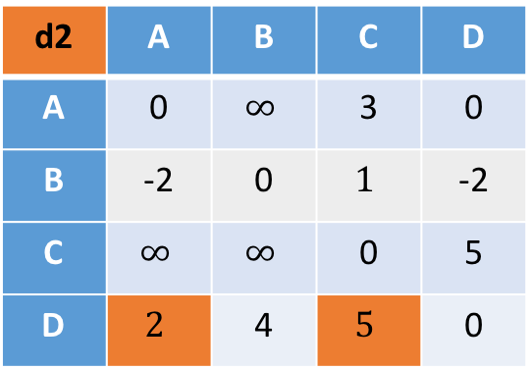
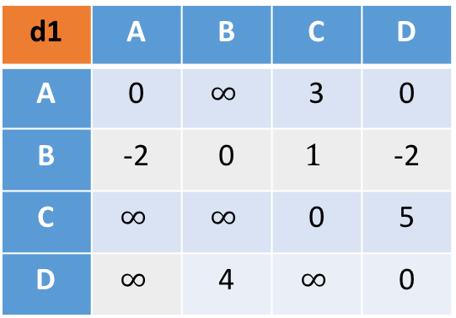
Second iteration: pitstop at B
to
d1 | A | B | C | D
A | 0 | $$∞$$ | 3 | 0
B | -2 | 0 | $$1$$ | -2
C | $$∞$$ | $$∞$$ | 0 | 5
D | $$∞$$ | 4 | $$∞$$ | 0
A
-2
B
from
3
1
4
0
to
C
D
d2 | A | B | C | D
A | 0 | $$∞$$ | 3 | 0
B | -2 | 0 | $$1$$ | -2
C | $$∞$$ | $$∞$$ | 0 | 5
D | $$2$$ | 4 | $$5$$ | 0
5
from

Slide 39


Third iteration: pitstop at C
to
d2 | A | B | C | D
A | 0 | $$∞$$ | 3 | 0
B | -2 | 0 | $$1$$ | -2
C | $$∞$$ | $$∞$$ | 0 | 5
D | $$2$$ | 4 | $$5$$ | 0
A
-2
B
from
3
1
4
0
to
C
D
d3 | A | B | C | D
A | 0 | $$∞$$ | 3 | 0
B | -2 | 0 | $$1$$ | -2
C | $$∞$$ | $$∞$$ | 0 | 5
D | $$2$$ | 4 | $$5$$ | 0
5
from

Slide 40
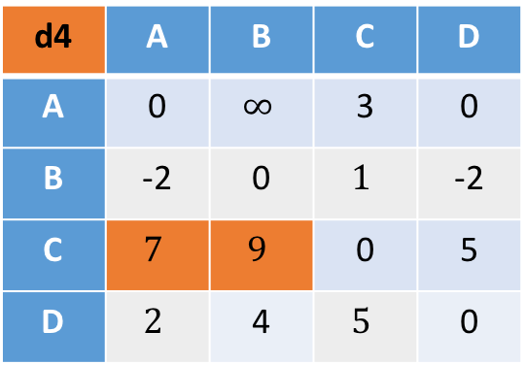

Fourth iteration: pitstop at D
to
d3 | A | B | C | D
A | 0 | $$∞$$ | 3 | 0
B | -2 | 0 | $$1$$ | -2
C | $$∞$$ | $$∞$$ | 0 | 5
D | $$2$$ | 4 | $$5$$ | 0
A
-2
B
from
3
1
4
0
to
C
D
d4 | A | B | C | D
A | 0 | $$∞$$ | 3 | 0
B | -2 | 0 | $$1$$ | -2
C | $$7$$ | $$9$$ | 0 | 5
D | $$2$$ | 4 | $$5$$ | 0
5
from

Slide 41
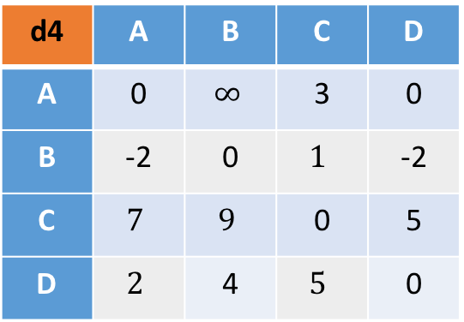
Finished!
A
-2
B
to
d4 | A | B | C | D
A | 0 | $$∞$$ | 3 | 0
B | -2 | 0 | $$1$$ | -2
C | $$7$$ | $$9$$ | 0 | 5
D | $$2$$ | 4 | $$5$$ | 0
3
1
4
0
from
C
D
5

Slide 42
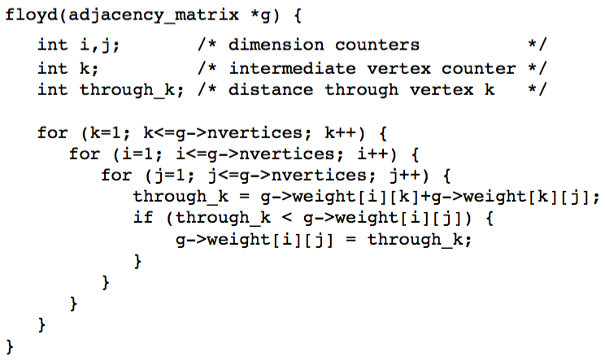
Source code:

Slide 43
